Slide 1

Bike Store Sales Data Analysis
Prepared By:
Arpan Shah

Slide 2

Business Story
In this project, we analyzed data from a bike store to gain insights into customer behavior, sales trends, and product popularity. The goal of this analysis is to help the bike store better understand its customers and optimize its product offerings and marketing strategies.
We have explored various aspects of the bike store such as product categories, monthly sales performance, and customer purchase behavior. By analyzing this data, we will be able to identify trends and patterns that can be used to optimize the store's offerings and improve its sales and profitability.
Overall, the insights gained from this analysis will provide the bike store with valuable information that can be used to make data-driven decisions and improve its overall performance in the highly competitive online bike retail industry.
Data Source : https://www.sqlservertutorial.net/sql-server-sample-database/

Slide 3
Database Information
sales.customers:
Customer Details: Customer ID(PK), First name, Last name, Phone, E-mail, Street, City, State, Zip code
Sales.orders:
Order Details: Order ID(PK), Order status, Order date, shipped date, Store ID(FK)
Sales.staffs
Staffs Details: Staff ID(PK), First name, Last name, E-mail, Phone, Active, Store ID, Manager ID(FK)
sales.stores
Stores Details: Store ID(PK), Store name, Phone, E-mail, Street, City, State, Zip code
sales.order_items
Ordered items Details: Order ID(PK), Item ID(FK), Quantity, List price, Discount.
production.categories:
Item Category Detail: Category ID(PK), Category name
production.products:
Product Details: Product ID(PK), Product name, Brand ID, Category ID(FK), Model year, List price
Production.stocks:
Stock Details: Store ID(PK), Product ID, Quantity
Production.brands:
Brand Details: Brand ID(PK), brand name

Slide 4
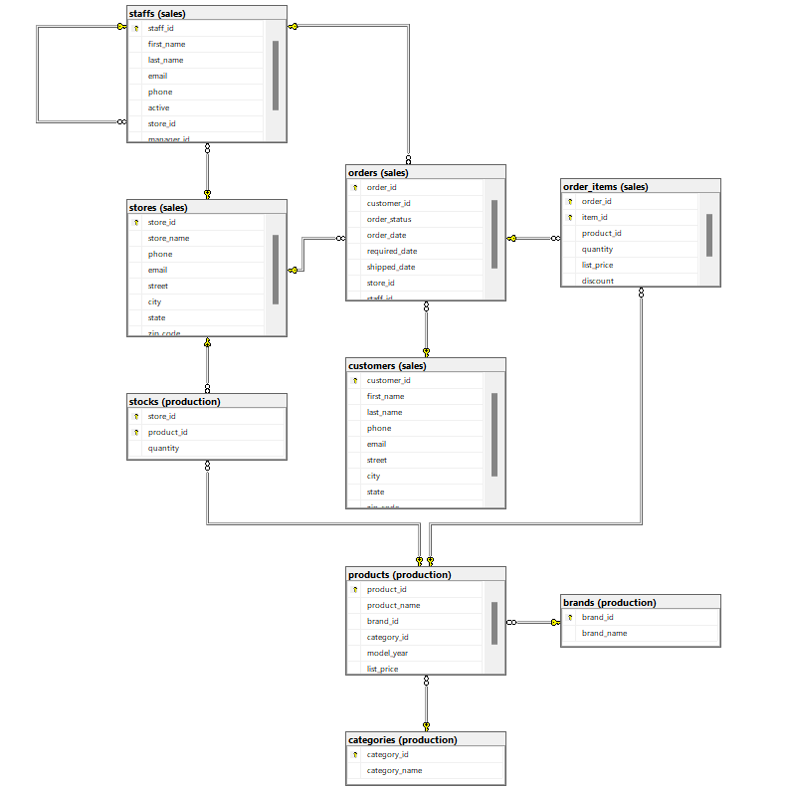
Schema

Slide 5
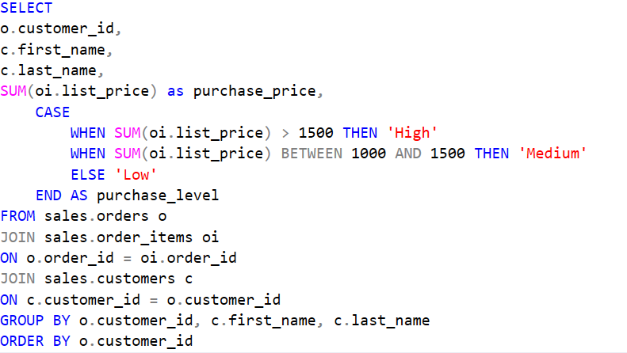
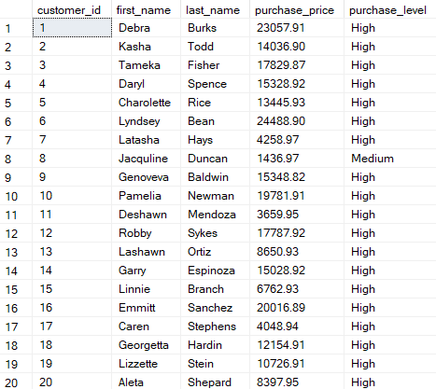
Business Question
What is the distribution of purchase levels (high, medium, low) among customers based on their total purchase price, and which customers fall into each category?

Slide 6
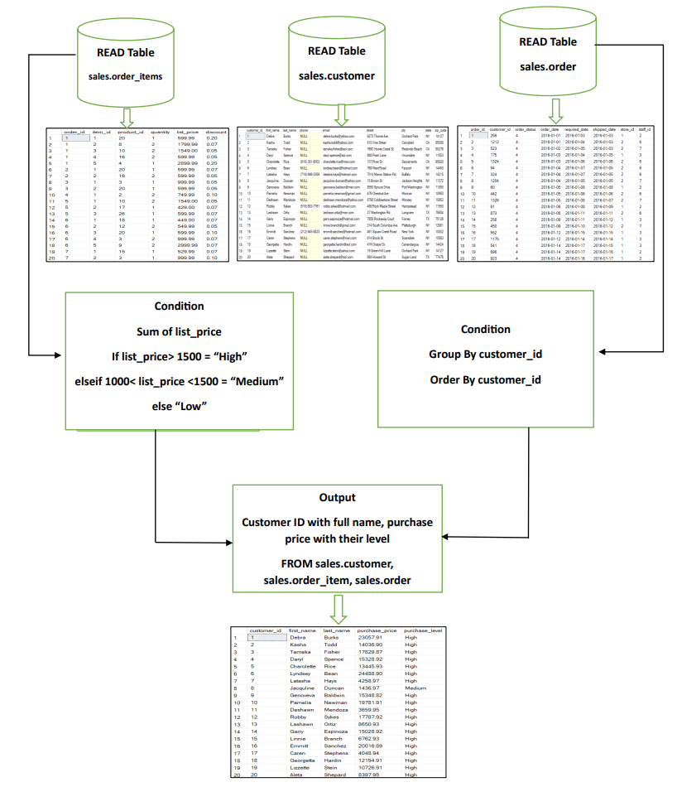
Dataflow Diagram

Slide 7
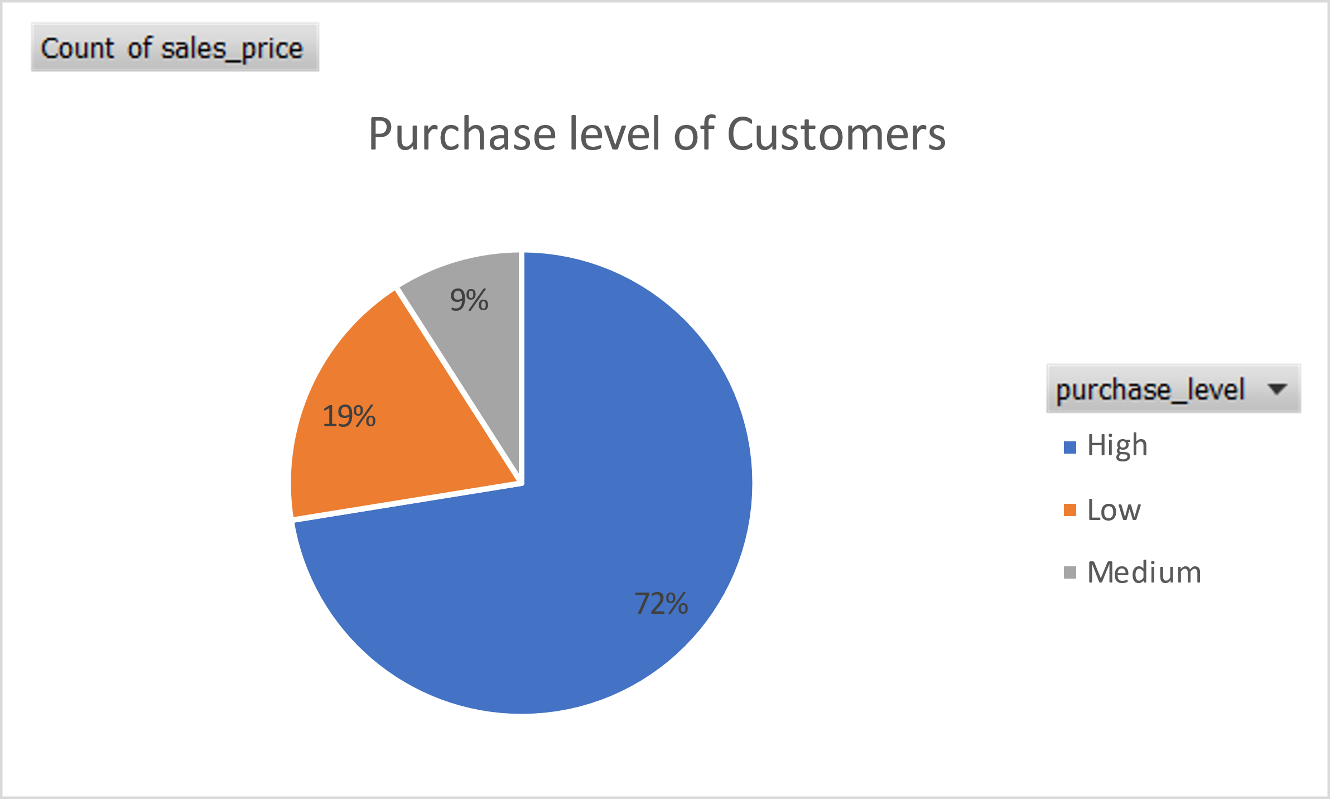
Visualization

Slide 8
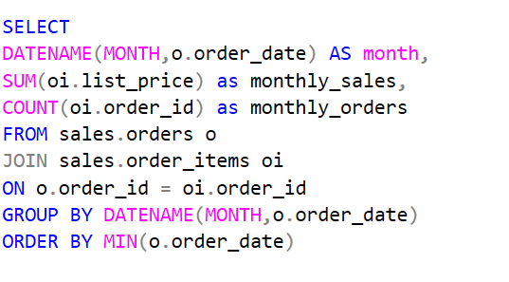
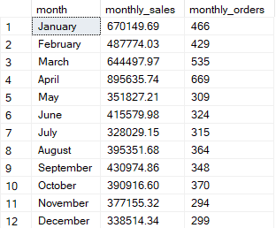
Business Question
What are the monthly sales and order volume trends of the store based on the order date, and how do they vary across different months?

Slide 9
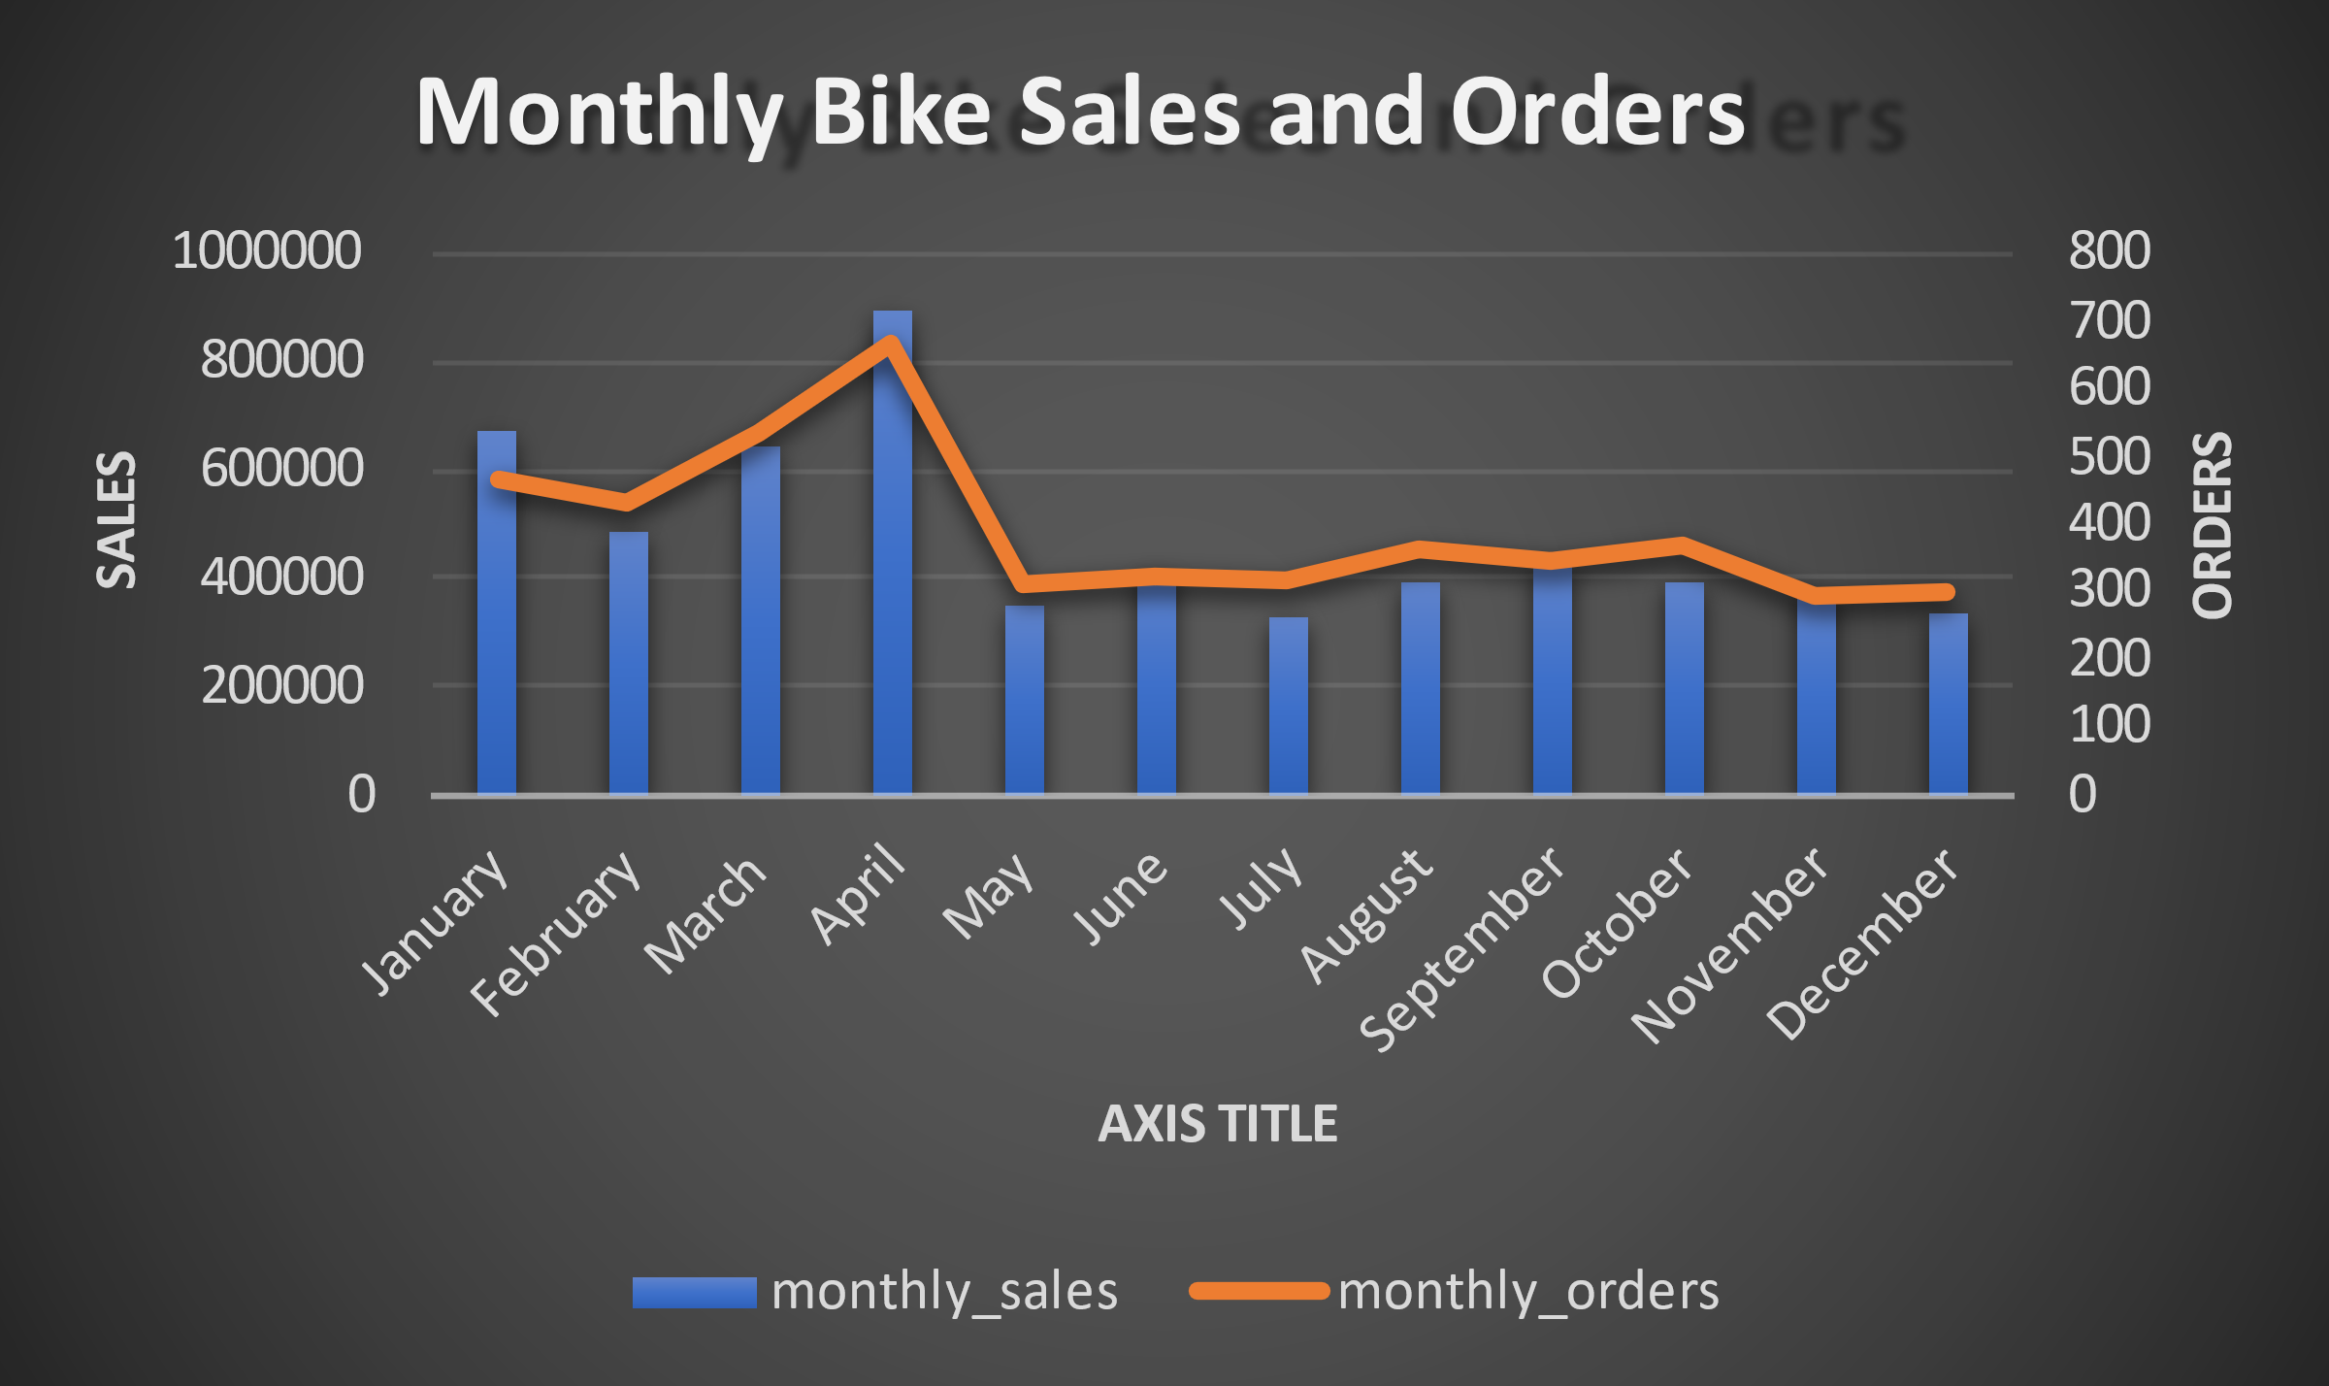
Visualization

Slide 10

Most challenging part of the project:
The most challenging part of this project was finding the dataset that fulfilled our requirements.
After searching for long, we found a dataset of music store.
At that time, we thought this dataset was perfect for our project. So, we performed data cleaning, created multiple tables in MS SQL server and run some queries but those queries were not giving us appropriate results.
At the end, we decided to change and look for another dataset.
Finally, after we got a dataset about bike store that gave us the desired results.

Slide 11

Memorable moments during the project:
Handle the challenges well by group members.
Every week, we collaborated with all group members to discuss regarding the project and solve difficulties together while we worked on project.
We were so happy after solving every problem that we faced in the project.
After overcoming every challenge, we are finally here to present this project and showcasing our skills. So, this is our memorable moments of the project.

Slide 12

Thank You!

